Slide 1


Final Year Project
Computer On Wheels
Supervised By: Dr. Rizwan Bin Faiz (Assistant Professor)

Slide 2
Project Team
Bilal Rafiq (27661)
Hamza Azhar(28595)
Sardar Mohsin (28016)
M. Usama Nazir (30445)

Slide 3
Table of Content
Opportunity & Stakeholders
Solution
Progress Report Summary
Requirements
Software System (Design + Implementation + Testing)
Endeavour (Team + Work + Way of Working)
Next Steps
Prototype/Report

Slide 4
Opportunity & Stakeholders

Slide 5
Opportunity(1/3)
According to a National Highway Traffic Safety Administration (NHTSA) study, driver error led to 94% of the crashes examined.
According to the U.S. General Services Administration (GSA), human error causes 98% of crashes.

Slide 6
Opportunity (2/3)
A 2017 study by RAND Corporation found that self-driving cars could reduce traffic fatalities by up to 25% by 2040.
A 2019 study by the National Highway Traffic Safety Administration (NHTSA) found that self-driving cars were involved in fewer crashes than human-driven cars per mile driven.
A 2020 study by the Massachusetts Institute of Technology (MIT) found that self-driving cars could prevent up to 90% of crashes caused by human error.

Slide 7
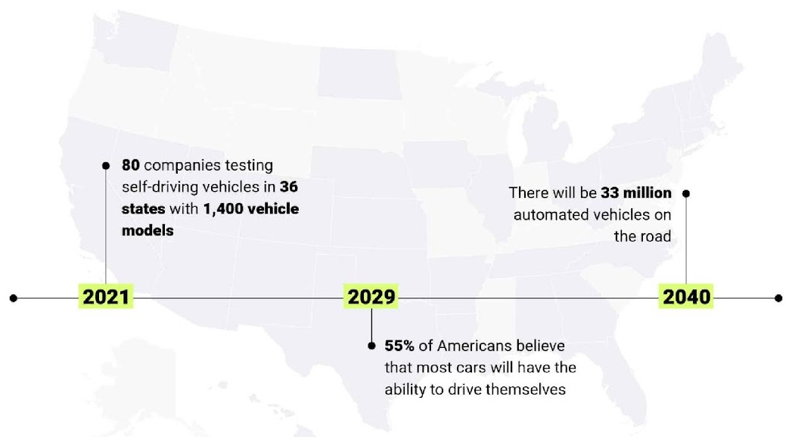
Opportunity (3/3)

Slide 8
Stakeholders
Driver
Passengers
Domain Expert

Slide 9
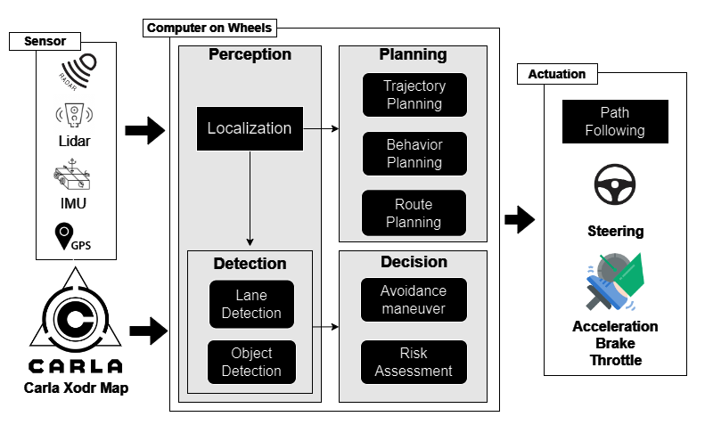
Solution
We propose a Self Driven Car, featuring optimized path planning, obstacle detection, dynamic avoidance for reliable and adaptable behavior in Urban Environment.

Slide 10
PROGRESS REPORT Summary

Slide 11
Requirements
Elicitation Techniques / Tools
Interviewing Domain Expert Interviews
Document Analysis
Notes:
While Interviewing Domain expert we have noted our Questions and created a Questionnaire like which Questions were asked at the time of meeting In Document Analysis we have gathered our requirements through Research articles.

Slide 12
Specification / Documentation:
Appendix-A: Software Requirements Specifications
Appendix-B: Design Documentation
Appendix-C: Coding Standards/Convention
Appendix-D:
Appendix-D1 Inspection
Appendix-D2 System Design Testing
Appendix-D3 White Box Testing
Appendix-E: Work Breakdown Structure
Appendix-F: Roles & Responsibility Matrix

Slide 13
Specification / Documentation:
Questionaries:
Questionaries for Gathering requirement
Questionnaire for Technical Feasibility and Risk Assessment
Questionnaire for Tools and Technologies
SWOT analysis
Progress Report / Document

Slide 14
List of Different Users
Driver
Passengers

Slide 15
Use Cases
Set Destination
Plan Route
Generate Waypoints
Navigate Generated Waypoint
Control Acceleration
Control Longitudinal Movement
Control Throttle
Notes:
This is the use case of only the implemented requirements means part 1

Slide 16
Use Cases
Control Lateral Movement
Control Steering
Assign lane
Control Jerkiness
Reach at Destination
Halt at Destination
Notes:
This is the use case of only the implemented requirements means part 1

Slide 17
Requirements
Functional Requirements(Vehicle Control)
No | Functional Requirement | Breakdown |  | Description
 |  | ID | Sub-Functionality
1 | Vehicle Control | 1.1 | Autonomous Navigation | The system shall be capable of autonomously navigating from a starting point to a destination.
1 | Vehicle Control | 1.2 | Acceleration Control | The system shall control the vehicle's acceleration to maintain desired speeds along the planned trajectory.
1 | Vehicle Control | 1.3 | Emergency Stop | The system shall include a mechanism for the driver to perform an immediate emergency stop, halting all vehicle operations.
1 | Vehicle Control | 1.4 | Throttle Control | The system shall control the throttle to regulate vehicle speed within a range of 0 to 120 km/h, adjusting for road conditions and traffic regulations.
1 | Vehicle Control | 1.5 | Steering Control | The system shall control the vehicle's steering to maintain a maximum lateral deviation of 0.5 meters from the planned trajectory under normal conditions.
1 | Vehicle Control | 1.6 | Braking Control | The system shall control the vehicle's braking to safely decelerate and stop as required by the planned trajectory
Notes:
Highlighted requirements are the implemented one in part 1

Slide 18
Requirements
Functional Requirements(Path Planning)
No | Functional Requirement | Breakdown |  | Description
 |  | ID | Sub-Functionality
2 | Path Planning | 2.1 | Route Calculation | The system shall calculate the most efficient route i.e. shortest path from the vehicle's current location to the driver-specified destination
2 | Path Planning | 2.2 | Lane Assignment | The system shall assign appropriate lanes for the vehicle to travel in along the calculated route, based on legal navigation rule.
2 | Path Planning | 2.3 | Waypoint Generation | The system shall generate waypoints along the calculated route to guide the vehicle towards the destination.
2 | Path Planning | 2.4 | Dynamic Obstacle Avoidance | The system shall adapt the vehicle's path in real-time to safely avoid unexpected obstacles.
2 | Path Planning | 2.5 | Map Reading | The system shall be able to read and interpret digital map data to determine the vehicle's precise location within the road network

Slide 19
Requirements
Functional Requirements(Path Following)
No | Functional Requirement | Breakdown |  | Description
 |  | ID | Sub-Functionality
3 | Path Following | 3.1 | Path smoothing | The system shall apply path smoothing techniques to limit acceleration changes to within 0.3 m/s², ensuring a smooth ride for passengers.
3 | Path Following | 3.2 | Lateral Control | The system shall maintain a lateral deviation of no more than 0.5 meters from the planned path under normal driving conditions.
3 | Path Following | 3.3 | Longitudinal Control | The system shall maintain a longitudinal deviation of no more than 1 meter from the planned path under normal driving conditions.
3 | Path Following | 3.4 | Speed Control | The system shall control the speed to reach the destination.
3 | Path Following | 3.5 | Waypoint Following | The system shall follow waypoints along the calculated waypoints to guide the vehicle towards the destination.

Slide 20
Requirements
Functional Requirements(Sensor Integration)
No | Functional Requirement | Breakdown |  | Description
 |  | ID | Sub-Functionality
4 | Sensor Integration | 4.1 | Inertial Measurement Unit Utilization | The system shall use an IMU to provide orientation and acceleration data at a frequency of 100 Hz.
4 | Sensor Integration | 4.2 | Global Positioning System Utilization | The system shall use GPS to determine the vehicle’s position.
4 | Sensor Integration | 4.3 | Radar/Lidar Utilization | The system shall utilize radar/lidar sensors to provide additional information about surrounding objects' velocity and distance, enhancing situational awareness.

Slide 21
Requirements
Functional Requirements(Trajectory Planning)
No | Functional Requirement | Breakdown |  | Description
 |  | ID | Sub-Functionality
5 | Trajectory Planning | 5.1 | Trajectory Generation | The system shall plan a smooth and optimal trajectory, based on destination specified by user.

Slide 22
Requirements
Functional Requirements(Obstacle Detection)
No | Functional Requirement | Breakdown |  | Description
 |  | ID | Sub-Functionality
6 | Obstacle Detection | 6.1 | Detection Using Sensors | The system shall utilize various sensors to detect obstacles in the vehicle's path.
6 | Obstacle Detection | 6.2 | Environmental Awareness | The system shall maintain the awareness of static and dynamic objects in the vehicles vicinity
6 | Obstacle Detection | 6.3 | Dynamic Obstacle Tracking | The system shall continuously track the moving obstacle.
6 | Obstacle Detection | 6.4 | Destination Estimation | The system shall be able to calculate the distance to detected obstacles
Notes:
Major part of part 2

Slide 23
Requirements
Functional Requirement(Obstacle Avoidance):
No | Functional Requirement | Breakdown |  | Description
 |  | ID | Sub-Functionality
7 | Obstacle Avoidance | 7.1 | Maneuver Execution | The system shall execute safe and efficient avoidance maneuvers to navigate around detected obstacles and maintain collision-free travel.
7 | Obstacle Avoidance | 7.2 | Steering Control | The system shall dynamically adjust steering angles to guide the vehicle away from obstacles and keep it on its intended path.
7 | Obstacle Avoidance | 7.3 | Re-Plan Path | The system shall re-plan the path, once the object is detected
7 | Obstacle Avoidance | 7.4 | Trajectory Adjustment | The system shall dynamically adjust the vehicle’s trajectory to avoid obstacle in some clear and clean environment.
7 | Obstacle Avoidance | 7.5 | Multi-Obstacle Handling | The system shall manage avoidance of multiple obstacles simultaneously

Slide 24
Requirements
Functional Requirement(Destination Arrival):
No | Functional Requirement | Breakdown |  | Description
 |  | ID | Sub-Functionality
8 | Destination Arrival | 8.1 | Destination Approach | The system shall approach the driver-specified destination with a positional accuracy of within 1 meter, following the calculated trajectory and waypoints.
8 | Destination Arrival | 8.2 | Stop at Destination | The system shall bring the vehicle to a complete stop within 1 meter of the designated destination, ensuring deceleration rates do not exceed 2 m/s² for passenger safety and comfort.

Slide 25
Requirements
Functional Requirements(User Inputs)
No | Functional Requirement | Breakdown |  | Description
 |  | ID | Sub-Functionality
9 | User Inputs | 9.1 | Ride Initiation | The driver shall be able to initiate journey.
9 | User Inputs | 9.2 | Destination Setting | The driver shall be able to input the desired destination, triggering the route planning process.

Slide 26
Requirements
Functional Requirements(System Integration)
No | Functional Requirement | Breakdown |  | Description
 |  | ID | Sub-Functionality
10 | System Integration | 10.1 | ROS Integration | The system shall utilize the Robot Operating System (ROS) to facilitate communication and data exchange between different software components.
10 | System Integration | 10.2 | Simulation Environment | Development and testing of the system shall be conducted in a simulated environment (e.g., CARLA simulator) for thorough validation before real-world deployment.

Slide 27
Requirements
Non-Functional Requirements
No | Non- Functional Requirement | ID | Description | Subfactor
1 | Safety Requirement | 1.1 | Ensure reliable object detection in adverse weather conditions to assure safety | Hazard Protection The system must detect and respond to hazards arising from adverse weather conditions, such as rain, fog, or snow, which may reduce visibility.
Notes:
Based on research paper, we only have this one NFR

Slide 28
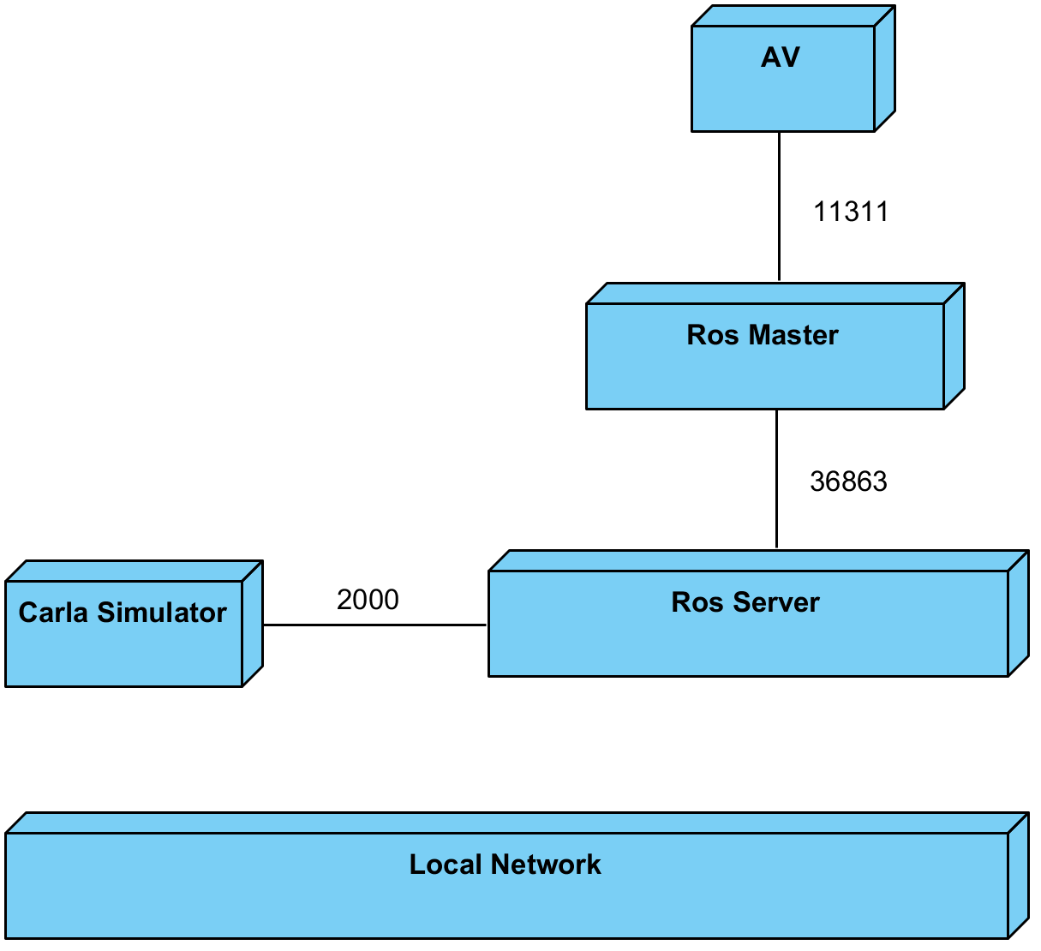
Design
Deployment Diagram:

Slide 29
Design
Detailed Design
Activity Diagrams
Sequence Diagram

Slide 30
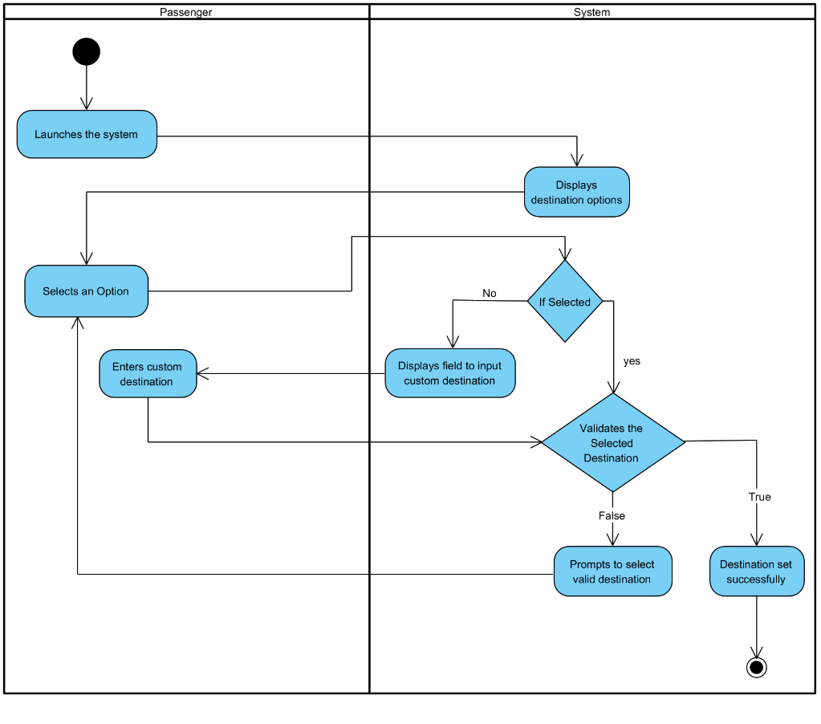
Design
Activity Diagram(Set Destination):

Slide 31
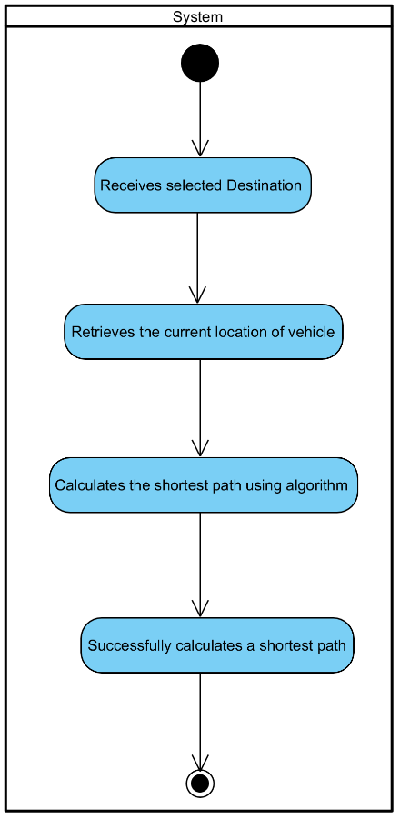
Design
Activity Diagram(Plan Route):

Slide 32
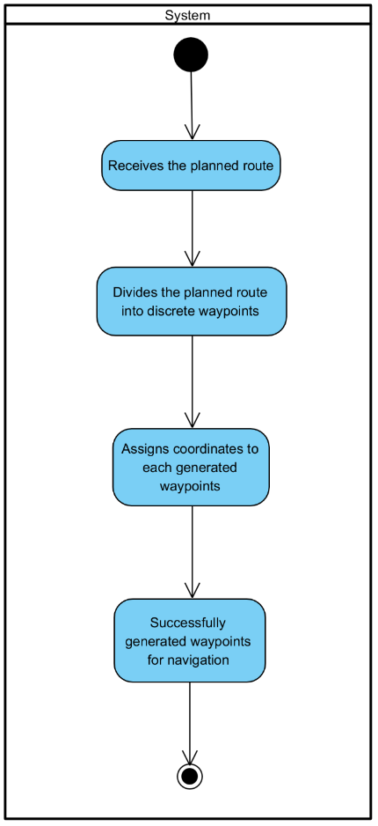
Design
Activity Diagram(Generate Waypoints):

Slide 33
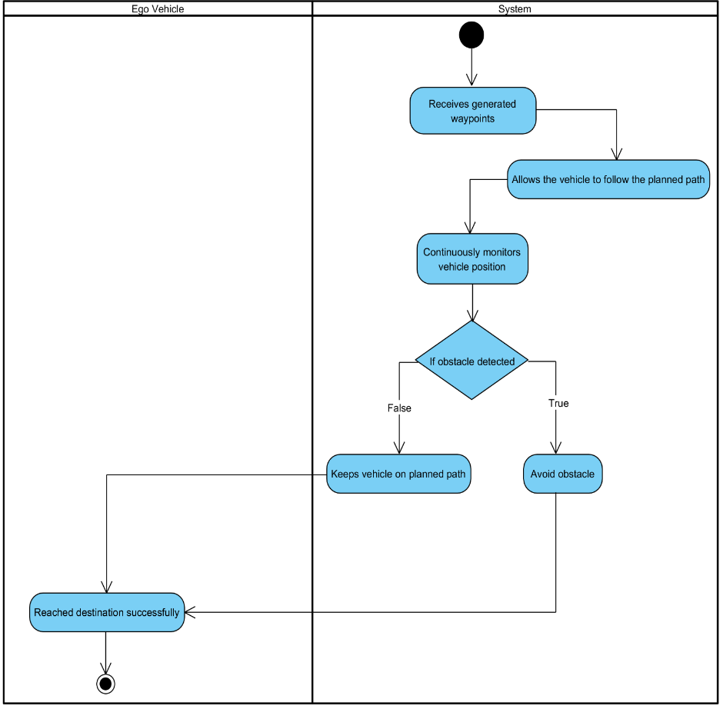
Design
Activity Diagram(Navigate Generated waypoints):

Slide 34
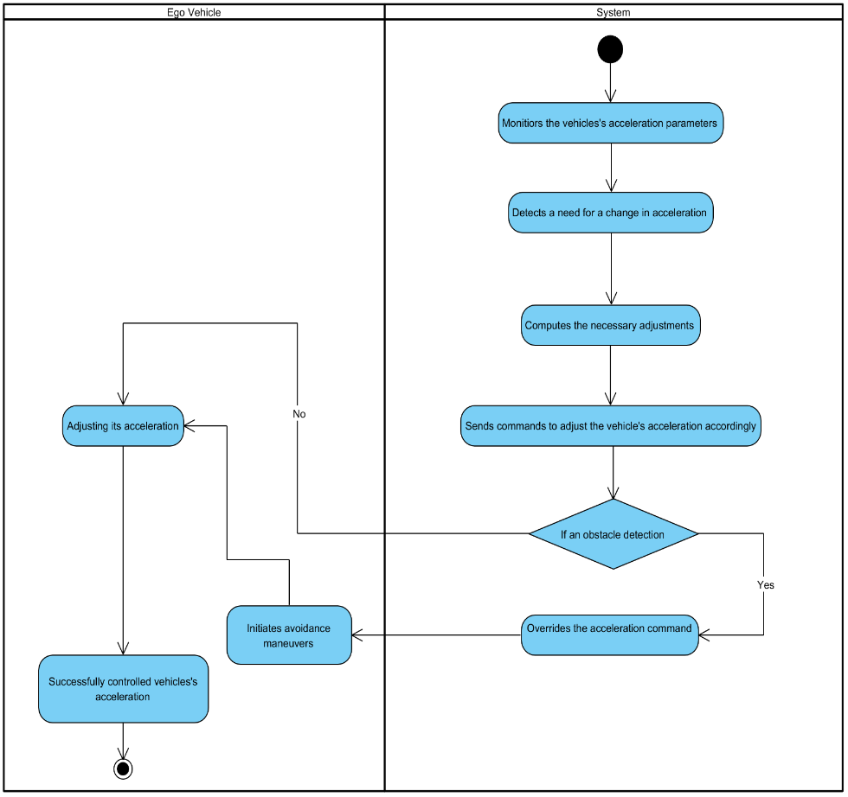
Design
Activity Diagram(Control Acceleration):

Slide 35
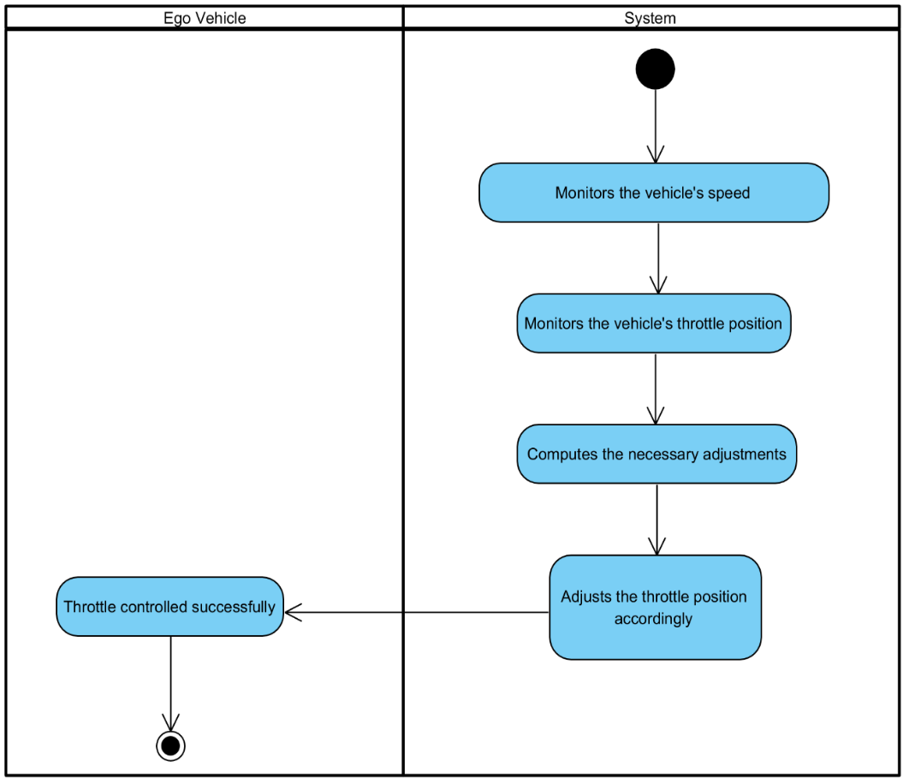
Design
Activity Diagram(Control Throttle):

Slide 36
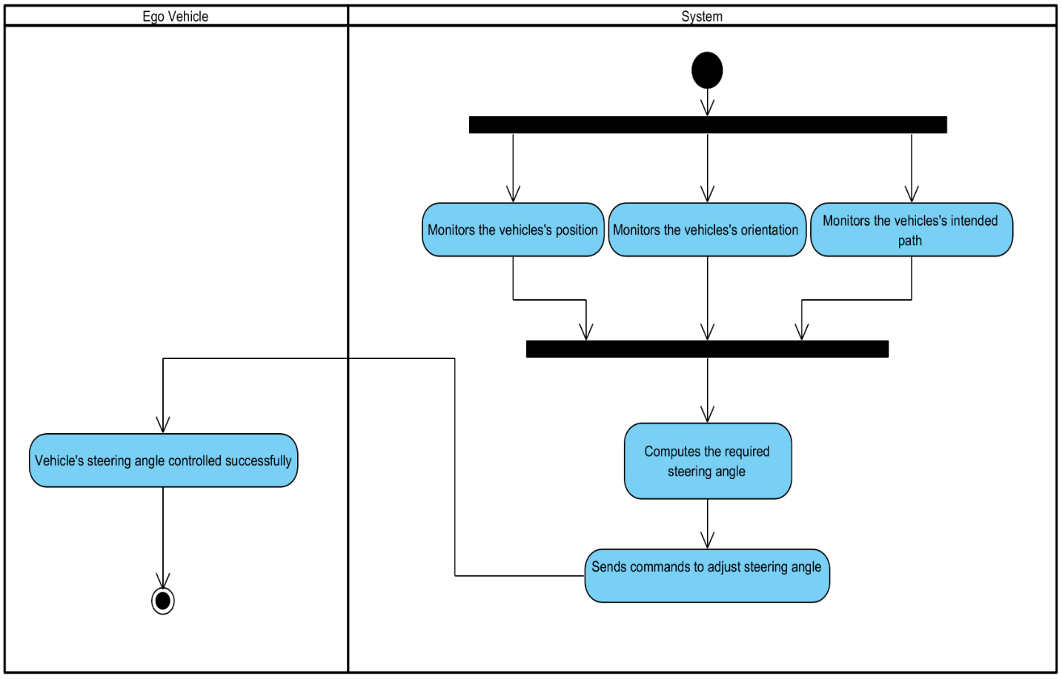
Design
Activity Diagram(Control Steering):

Slide 37
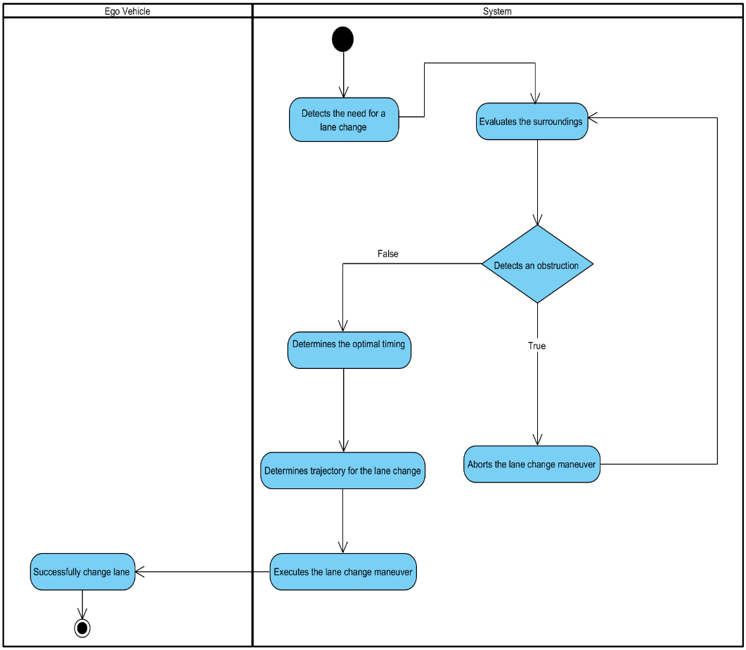
Design
Activity Diagram(Assign Lane):

Slide 38
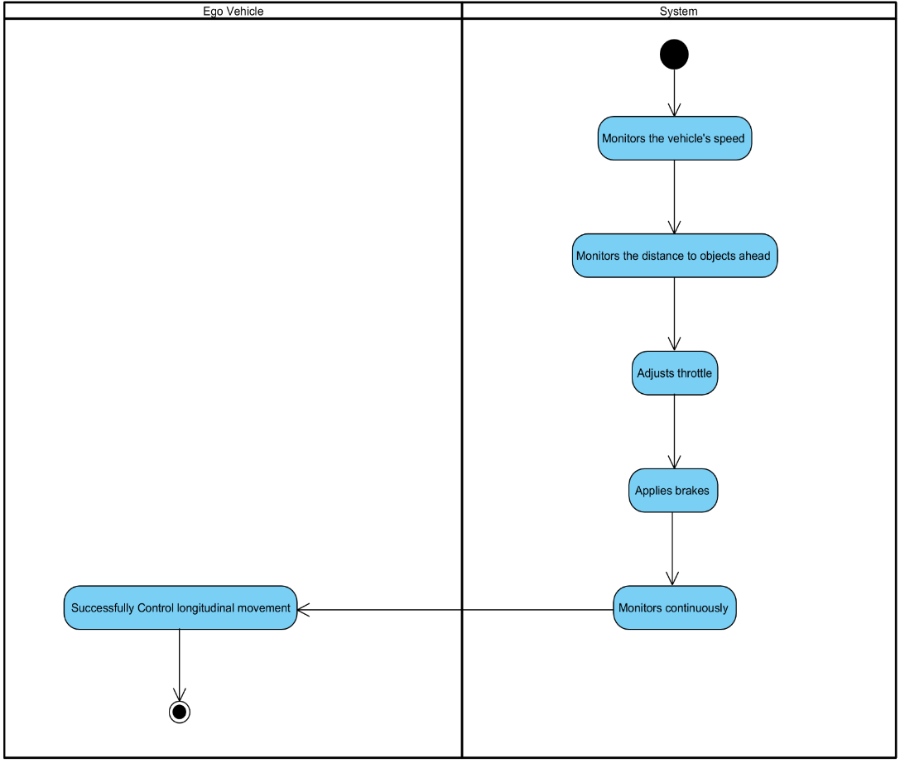
Design
Activity Diagram(Control Longitudinal Movement):

Slide 39
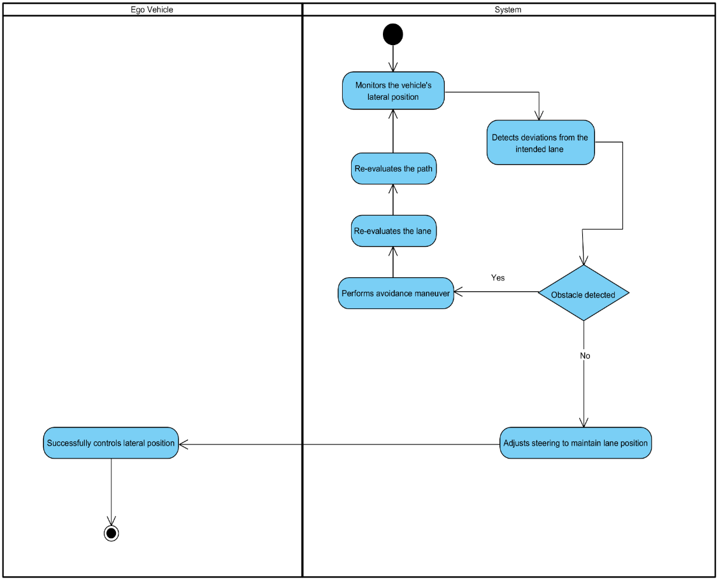
Design
Activity Diagram(Control Lateral Movement):

Slide 40
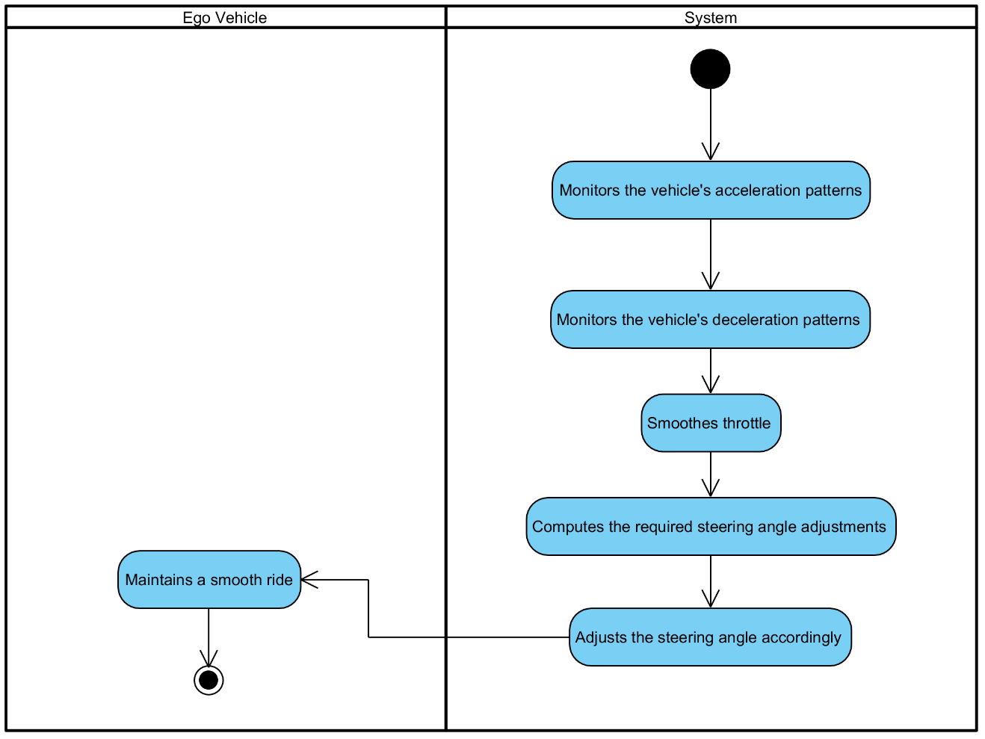
Design
Activity Diagram(Control Jerkiness):

Slide 41
Design
Activity Diagram(Reach at Destination):

Slide 42
Design
Activity Diagram(Halt at Destination):

Slide 43
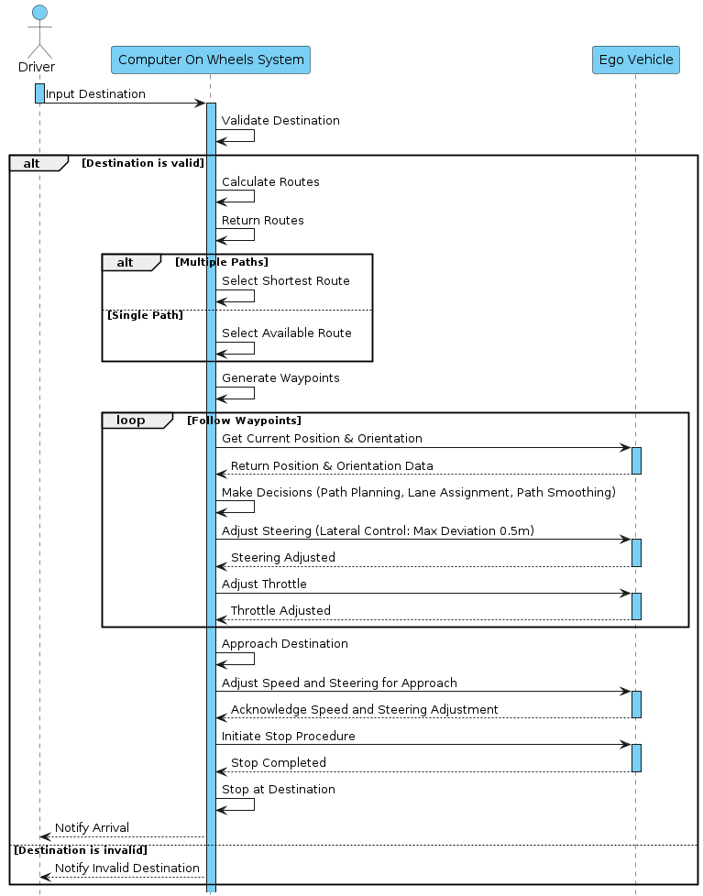
Design
Sequence Diagram:

Slide 44
Implementation
List Development Tools & Technologies
List Best Practices / Coding Standards
List Libraries / Components / Web Services

Slide 45
Implementation
List Development Tools & Technologies
Tools
Ubuntu
GitHub
Jira
Microsoft office
Visual Paradigm
Anaconda

Slide 46
Implementation
2. Technologies
Carla Simulator
Carla-Ros-Bridge
ROS Noetic
Rospy
Gazebo
Robot_localization
Python

Slide 47
Implementation
List Best Practices / Coding Standards
Software Engineering Practice:
In our project, we adopted a comprehensive and systematic approach to software engineering practices to ensure the delivery of a scalable and maintainable autonomous vehicle software system. Our methodology was influenced by industry best practices and tailored to meet the specific needs of our project. Key practices included:
Feature-Driven Development

Slide 48
Implementation
Feature-Driven Development:
We implemented the Feature-Driven Development (FDD) methodology which falls under the umbrella of Agile methodologies to manage our workflow efficiently and adapt to changing requirements. Utilizing Jira as our project management tool, we maintained a visual feature list and tracked progress seamlessly. Our agile approach included:
Regular Supervisor Meetings: Conducted weekly meetings with supervisors to review progress, address challenges, and incorporate feedback. These meetings ensured alignment with project goals and facilitated timely decision-making.
Feature List Management: Created and maintained a comprehensive feature list that broke down the system into small features. This list served as the backbone of our development process, guiding incremental and iterative development.
Incremental Development: Emphasized continuous and iterative development, delivering small, functional parts of the project regularly. This approach allowed for frequent validation, adjustment, and integration of new requirements.

Slide 49
Implementation
List of Coding Standards
1. Python coding Standards
Use snake_case for variable and function names.
Use CamelCase for class names.
Follow PEP 8 guidelines for code formatting.
Use meaningful variable and function names.
Keep lines of code within 79 characters.
Use comments to explain complex parts of the code.
Use docstrings to document modules, classes, and functions.
Avoid using global variables unless necessary.
Handle exceptions gracefully.
Use virtual environments to manage dependencies.

Slide 50
Implementation
List of Coding Standards
2. Rospy coding Standards
Follow Python coding standards for rospy code.
Use rospy naming conventions for nodes, topics, and services.
Utilize rospy log functions for logging messages.
Ensure ROS dependencies are properly declared in package.xml and CMakeLists.txt.
Document ROS nodes, topics, and services using ROS comments.
Use rospy's rospy.spin() to keep the node alive.
Handle ROS messages and services according to their specifications.
Use rospy's parameter server for managing node parameters.
Implement proper error handling for ROS communication.

Slide 51
Implementation
List of libraries:
rospy (for ROS-based development)
NumPy (for numerical computations)
math (for mathematical operations)
keyword (for parsing Python keywords)
xmltodict (for handling XML data)
os (for interacting with the operating system)
carla_msgs (for CARLA-specific ROS messages)
sensor_msgs (for sensor-related ROS messages)
OpenCV (for computer vision tasks)
Pandas (for data manipulation and analysis)
Matplotlib (for data visualization)
TensorFlow or PyTorch (for deep learning, if applicable)
Gazebo (for simulation, if using alongside CARLA)
RViz (for visualization in ROS)

Slide 52
Implementation
List of Components:
Map Parser
Traffic Generator
Path Planner
Trajectory Follower
Obstacle Detector
Obstacle Avoider
Localization Module
Sensor Data Fusion
Control System
Decision-Making Module
Simulation Environment

Slide 53
Testing
SRS => Defect Reduction/Identification:
Inspection Through Checklist (D1)
System Design => Defect Detection:
Scenario based test cases (D2)
Implementation => Defect Detection:
White Box Testing (D3)

Slide 54
Endeavour
Describe roles of your team members
Describe your software development process
Describe your way of working as a team

Slide 55
NEXT STEPS

Slide 56
Work Breakdown Structure (List of all Deliverables / Strikethrough Completed Deliverables)
Project Management
1.1 Jira Project Management Tool
1.2 Work Breakdown Structure (WBS)
1.3 Roles & Responsibility Matrix
1.4 Change Control Plan
1.5 Meeting minutes and Progress report
Reports / Documentation
2.1. Team Members and Project Proposal
2.2. Project Proposal Document
2.2.1. Opportunity and Stakeholders
2.2.2. Challenges Goals and Objectives
2.2.3. Solution Overview diagram
2.2.4. Report Outline
2.3. Literature / Market Survey
2.3.1 Domain Expert Interview Findings
2.3.2 Questionnaire for Technical Feasibility and Risk Assessment
2.3.3 Brainstorming diagram
2.3.4 Academic Research Review
2.3.5 Gap analysis summary
2.3.6 Technology Landscape
2.3.6.1 SWOT analysis
2.3.7 Questionnaire for Selecting tools and techniques
2.3.8 Specialization - 4 courses series from Coursera

Slide 57
Work Breakdown Structure (List of all Deliverables / Strikethrough Completed Deliverables)
2.4 Requirement Analysis
2.4.1 Problem Scenarios
2.4.2 Requirement Elicitation
2.4.3 Questionnaire for gathering requirements
2.4.4 Functional Requirements
2.4.5 Non-Functional Requirement
2.4.6 Inspection Report
2.4.7 Software requirement specification artifact
2.5 System Design
2.5.1 Architecture Diagram
2.5.2 Use Case Diagram
2.5.3 Detail Use Cases
2.5.4 Activity Diagrams
2.5.5 System Sequence Diagram
2.6 Implementation
2.6.1 Components and Libraries
2.7 Testing and Performance Evaluation
2.7.1 Test Scenarios
2.8 Conclusion & Outlook
2.8.1 Future Recommendations
2.9 Progress Presentation
2.9.1 Slides outlining project progress
2.9.2Updated Artifacts

Slide 58
Work Breakdown Structure (List of all Deliverables / Strikethrough Completed Deliverables)
2.9.2.1 Appendix-A: Software Requirements Specifications (SRS)
2.9.2.2 Appendix-B: Design Documents
2.9.2.3 Appendix-C: Coding Standards/Conventions
2.9.2.4 Appendix-D: Test Scenarios
2.9.2.5 Appendix-E: Work Breakdown Structure
2.9.2.6 Appendix-F: Roles & Responsibility Matrix
2.9.3 Answers to potential questions report
2.10 Final Presentation part 2
2.10.1 Comprehensive Slides for presentation
2.10.2 Working software system (Complete)
2.10.3. Updated Artifacts (Complete)
2.10.3.1. Appendix-A: Software Requirements Specifications (SRS)
2.10.3.2. Appendix-B: Design Documents

Slide 59
Work Breakdown Structure (List of all Deliverables / Strikethrough Completed Deliverables)
2.10.5 Final Report
3. System
3.1 Development Environment
3.1.1. IDE
3.1.1.1. Visual Studio Code
3.1.1.2. PyCharm
3.1.2 Version Control
3.1.2.1. Git Hub
3.1.3 Environment Management
3.1.3.1. Anaconda Distribution
3.2 Simulation Environment Setup
3.2.1 CARLA Simulator
3.2.1.1. Carlaviz for CARLA Visualization
3.2.2. ROS Noetic Configured
3.2.3. CARLA-ROS Bridge Integrated
3.2.4. Vehicle spawn module
3.2.5. Sensor spawn module
3.2.6. Destroy Vehicle module
3.3 Path Planning component
3.3.1. Map Reading module
3.3.2. Graph of Roads
3.3.3. Graph of Lanes
3.3.4. List of Driving Lanes within map

Slide 60
Work Breakdown Structure (List of all Deliverables / Strikethrough Completed Deliverables)
3.3.5. Route Calculation module
3.3.6. Algorithm implementation module
3.3.7. Global route planner module
3.3.8. Axis Translation module
3.3.9. Local route planner module
3.3.10. Environment Analysis module
3.3.11. Trajectory Generation module
3.3.12. Junction handling module
3.4. Path Following component
3.4.1. Trajectory Tracking module
3.4.2. Basic agent module
3.4.3. Behaviour agent module
3.4.4. Algorithm implementation module
3.4.5. Controller module
3.4.6. Custom Destination module
3.5. Vehicle Control component
3.5.1. Throttle Control module
3.5.2. Braking Control module
3.5.3. Acceleration Control module
3.5.4. Steering Control module
3.5.5. Longitudinal Control module
3.5.6. Lateral Control module
3.5.7. Lane changing module
3.5.8. Jerkiness Control algorithm modules
3.5.9. Rotation and Translation module

Slide 61
Work Breakdown Structure (List of all Deliverables / Strikethrough Completed Deliverables)
3.5 Sensor Integration module
3.5.1 IMU integration sub-module
3.5.2 GPS integration sub-module
3.5.3 Radar integration sub-module
3.5.4 Lidar integration sub-module
3.6 Obstacle Detection
3.6.1. Sensor Fusion module
3.6.1.1. Lidar-Radar Fusion sub-module
3.6.1.2. Multi-sensor Data synchronization sub-module
3.6.2. Sensor Data Processing module
3.6.3. Obstacle Detection module
3.6.3.1. ML based detection sub-module
3.6.4. Distance Estimation module
3.6.5. Object Classification module
3.7 Obstacle Avoidance
3.7.1 Dynamic Obstacle handling module
3.7.2 Static Obstacle handling module
3.7.3 Path Adjustment module
3.7.3.1. Map based planning sub-module
3.7.3.2. Graph based planning sub-module
3.7.4. Trajectory Estimation module

Slide 62
Work Breakdown Structure (List of all Deliverables / Strikethrough Completed Deliverables)
3.7.5. Maneuver Planning module
3.7.5.1. Environmental evaluation sub- module
3.7.5.2. Lane changes sub-module
3.7.5.3. Decelerate sub-module
3.7.5.4. Emergency Stop sub-module
3.7.6. Real-time Response module
3.7.7. Tracking module
3.7.7.1. Kalman filter sub-module
3.7.7.2. Particle filter sub-module
4. Open House
4.1. Event Part 1
4.1.1. Standee Design
4.1.2. Printed Standee
4.1.3. Printed Broachers
4.1.4. Pre-recorded Demo video
4.2. Event Part 2
4.2.1. Standee Design
4.2.2. Printed Standee
4.2.3. Printed Broachers
4.2.4. Full Working Software

Slide 63
Challenges
1. Resource Intensive:
Requires significant computational resources and specialized hardware for simulations and real-world testing.
2. Complex Integration:
Integrating multiple technologies and ensuring seamless communication between them can be challenging.
3. High Learning Curve:
The complexity of tools and frameworks such as ROS and CARLA may require significant training and ramp-up time.
.
Notes:
Based on SWOT

Slide 64
Challenges
4. Limited Testing Scenarios:
Simulated environments might not cover all possible real-world scenarios, potentially limiting the robustness of the solution.
5. Dependency on External Tools:
Relying on external simulators and libraries can introduce vulnerabilities if there are updates. or changes beyond your control.

Slide 65
Prototype
Demonstration of actual working system

Slide 66
Report

Slide 67
Report
Chapter 1: Introduction
Chapter 2: Literature / Market Survey
Chapter 3: Requirement Analysis
Chapter 4: System Design
Chapter 5: Implementation
Chapter 6: Testing & Evaluations
Chapter 7: Conclusion & Outlook

